Slide 1
Memory & Forgetting
Chapter-4
Raheela Tariq

Slide 2
Memory is storage and retrieval of information
In psychology, memory is an organism's mental ability to store, retain and recall information.
Memory is the retention of, and ability to recall, information, personal experiences, and procedures (skills and habits).
‘Memory’ is a label for a diverse set of cognitive capacities by which humans and perhaps other animals retain information and reconstruct past experiences, usually for present purposes.

Slide 3
Memory
Memory is our ability to encode, store, retain and subsequently recall information and past experiences in the human brain.
Ryburn defines memory as “the power we have to store our experiences and to bring them into the field of consciousness sometimes after the experiences have occurred”
The process of memorization , can not be viewed merely in terms of reproduction or revival of past experiences or learning. It is quite a complex process which involves factors like learning, retention, recall and recognition .

Slide 4
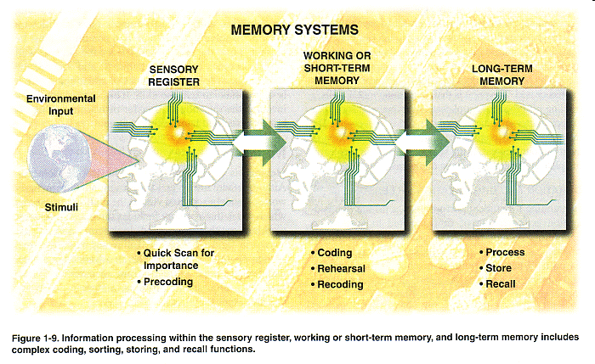

Slide 5
Brain Areas Included in Memory
The hippocampus, a primitive structure deep in the brain, plays the single largest role in processing information as memory.
The amygdala, an almond-shaped area near the hippocampus, processes emotion and helps imprint memories that involve emotion.
The cerebral cortex, the outer layer of the brain, stores most long-term memory in different zones, depending on what kind of processing the information involves: language, sensory input, problem-solving, and so forth.
In addition, memory involves communication among the brain’s network of neurons, millions of cells activated by brain chemicals called neurotransmitters.

Slide 6
The Atkinson-Shiffrin model (also known as the Multi-store model, Multi-memory model and the Modal model) is a psychological model proposed in 1968 by Richard Atkinson and Richard Shiffrin as a proposal for the structure of memory. It proposed that human memory involves a sequence of three stages:
Sensory memory (SM)
Short-term memory (STM)
Long-term memory (LTM)

Slide 7
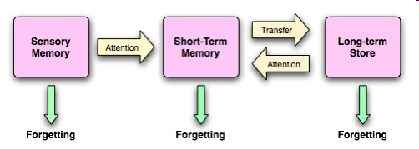

Slide 8
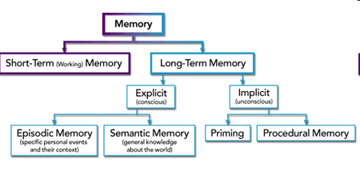
Types Of Memory

Slide 9
Sensory Memory
Sensory memory holds information of sensory input for brief periods of time i.e few seconds
There are different sensory registers for each of the senses.
The iconic memory lasts about half a second and the echoic memory lasts several seconds.
Visual sensory memory—brief memory of an image or icon. Also called iconic memory.
Auditory sensory memory—brief memory of a sound or echo. Also called echoic memory.

Slide 10
Short term Memory
Short-term memory—closely related to “working” memory—is the very short time that you keep something in mind before either dismissing it or transferring it to long-term memory. Short-term memory is shorter than you might think, lasting less than a minute. It’s what allows you to remember the first half of a sentence you hear or read long enough to make sense of the end of the sentence. But in order to store that sentence (or thought, fact, idea, word, impression, sight, or whatever else) for longer than a minute or so, it has to be transferred to long-term memory.

Slide 11
Working Memory is another name for Short Term Memory.
It involves, memory span
It can be improved by using chunking and mnemonics.

Slide 12
Memory Span
Memory span: The number of items, usually words or numbers, that a person can retain and recall. Memory span is a test of working memory (short-term memory). In a typical test of memory span, an examiner reads a list of random numbers aloud at about the rate of one number per second. At the end of a sequence, the person being tested is asked to recall the items in order. The average span for normal adults is seven to nine.

Slide 13
Long Term Memory (LTM)
It is a memory system for the retention of large amounts of information for long periods of time. It is the memory system that permits us to remember events that happened many years ago, yesterday, last year, and so on.
It is the long term memory that allows you to remember factual information.
LTM codes information according to meaning, pattern and other characteristics.
For example; to learn different subjects, appear in the examinations and perform communication with others etc. It brings continuity and meaning in our life.
Storing information relatively permanently Stored on basis of meaning and importance.

Slide 14
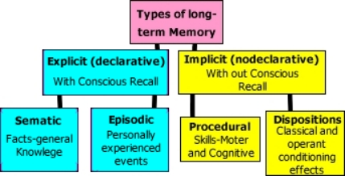
Types of LTM
Declarative/explicit memory
NonDeclarative/Implicit/Procedural memory

Slide 15
Declarative/Explicit Memory
“Knowing what”
Memory of facts and events.
Refers to those memories that can be consciously recalled or declared.
Divided into;
  Episodic memory
  Sematic Memory
Encoded by hippocampus, stored in temporal cortex.

Slide 16
Episodic & Semantic
Episodic memory is connected with episodes and events. It my consist of personal events and experiences associated with one’s life.
What event has happened during one’s life is stored in the shape of episodic memory traces organized according to time, space and other characteristics.
Thus episodic memory is the memory which depends on retrieving the particular events or episodes experienced by a person through his direct or indirect experiences.

Slide 17
Semantic memory helps in storing as well as retrieving a collection of relationships between events or association of ideas.
It is based on general knowledge coupled with meaningful interpretation, generalized rules, principles and formulae. For example, CO2, name of capital of the state.
Semantic memory impressions are more or less permanent. Their recall does not necessarily depends on the retrieval of some specific episodes from the past.
Sematic memory is not as personal as episodic.
For example, meaning of the symbol CO2, name of capital of the state are common to each individuals

Slide 18
Non declarative/ Implicit/ Procedural Memory
“Knowing how”
Unconscious memory of skills and how to do things. For example, use of objects and movement of body like tying a shoe lace, riding a bike etc.
Usually acquired through repetition and practice.

Slide 19
They are automatic sensorimotor behaviors that are so deeply embedded that we are no longer aware of them
Divided into two parts
  Procedural
  Condition Disposition

Slide 20
Procedural Memory
Procedural memory is the long-term memory of skills and procedures, or "how to" knowledge (procedural knowledge).
It is considered a form of implicit memory.

Slide 21
Types of Implicit Memory
Procedural: Procedural memory is the type of implicit memory that enables us to carry out commonly learned tasks without consciously thinking about them. For example, tying a shoe.
Condition: When a particular/similar condition occurs in which the similar act has to be performed that is already learned.
Disposition: It is used to while an individual is trying to retrieve from storage or encode new information .

Slide 22
Memory Process
Human memory, like memory in a computer, allows us to store information for later use. In order to do this, however, both the computer and we need to master three processes involved in memory.
Encoding
Storage
Retrieval

Slide 23
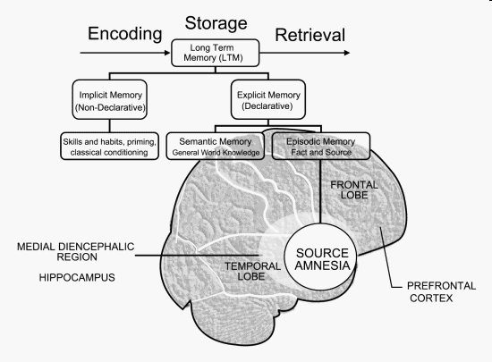

Slide 24

Storage is the process of retaining the information gathered in the initial stages of encoding.
Memory storage is made up of three memory systems: sensory memory, short-term memory, and long-term memory.
Sensory memory extends the duration of the perception of stimuli long enough that they can be recognized, transformed (encoded), and relayed to conscious awareness.
Short-term memory (STM) has a limited duration (15 to 30 seconds) and a limited capacity, believed to be about seven pieces of information.
Long-term memory (LTM) has an unlimited capacity and a very long duration; it is virtually limitless
}
}

Slide 25
Encoding:
The process we use to transform information so that it can be stores.
Storage:
It simply means holding onto the information.
Retrieval:
It is bringing the memory out of storage and reversing the process of encoding. In other words, return the information to a form similar to what we stored.

Slide 26
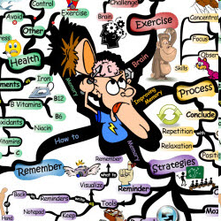
Methods of Improving Memory

Slide 27
RECALL:
This involves digging into the memory and bringing back information on a stimulus/response basis, e.g., "What is the capital of New Zealand?" Answer: "Wellington". Recall often needs prompting with cues to help us retrieve what we are looking for. It is not a reliable form of memory and many of us experience the feeling that we know the answer but simply can't dig the information out. This is the technique we use to remember people's names, hence we often forget them. There are three types of recall:
Free recall: when no cues are given to assist retrieval
Serial recall: when items are recalled in a particular order
Cued recall: when some cues are given to assist retrieval

Slide 28
Recognition (re+cognition) is a process that occurs in thinking when some event, process, pattern, or object recurs. Coming from the base cognition; cognition has various uses in different fields of study and has generally accepted to be used for the process of awareness or thought.

Slide 29
RELEARNING:
Another means of remembering is through relearning. Relearned information may return quickly, even if it hasn't been used for many years.
Also called saving score method.

Slide 30
Tips for memory improvements
Brain exercises
Memory, like muscular strength, is a “use it or lose it” proposition. The more you work out your brain, the better you’ll be able to process and remember information.
Aerobics:
The best way to improve our memories seems to be to increase the supply of oxygen to the brain, which we can do by aerobic exercising. Walking for three hours each week suffices, as does swimming or bicycle riding.

Slide 31
General guidelines to improve memory
Pay attention:
You can’t remember something if you never learned it, and you can’t learn something — that is, encode it into your brain — if you don’t pay enough attention to it.
Involve as many senses as possible.
Relate information to what you already know.
Organize information.

Slide 32
Understand and be able to interpret complex material.
Rehearse information frequently and “over-learn”.
Be motivated and keep a positive attitude.

Slide 33
Healthy habits to improve memory
Regular exercise
Reduces the risk for disorders that lead to memory loss, such as diabetes and cardiovascular disease.
Increases oxygen to your brain.
3. May enhance the effects of helpful brain chemicals and protect brain cells.
Managing stress
Cortisol, the stress hormone, can damage the hippocampus if the stress is unrelieved.
Stress makes it difficult to concentrate.
Good sleep habits
Sleep is necessary for memory consolidation.
Sleep disorders like insomnia and sleep apnea leave you tired and unable to concentrate during the day.
Not smoking
Smoking heightens the risk of vascular disorders that can cause stroke and constrict arteries that deliver oxygen to the brain.

Slide 34
Memory and aging
Several factors cause aging brains to experience changes in the ability to retain and retrieve memories:
The hippocampus is especially vulnerable to age-related deterioration, and that can affect how well you retain information.
There’s a relative loss of neurons with age, which can affect the activity of brain chemicals called neurotransmitters and their receptors.
An older person often experiences decreased blood flow to the brain and processes nutrients that enhance brain activity less efficiently than a younger person.

Slide 35

FORGETTING

Slide 36
Forgetting (retention loss) refers to apparent loss of information already encoded and stored in an individual's long term memory. It is a spontaneous or gradual process in which old memories are unable to be recalled from memory storage.

Slide 37
AMNESIA
“Amnesia is loss of ability to memorize information or to recall information stored in memory.”

Slide 38
WHAT CAUSES
AMNESIA?
Amnesia is most commonly associated with either brain damage through injury or degeneration of brain cells in dementia.

Slide 39
FORMS OF AMNESIA
ANTEROGRADE AMNESIA:
In Anterograde amnesia patient cannot retain any new memory.
RETROGRADE AMNESIA:
In Retrograde amnesia the patient cannot recall the past events.

Slide 40
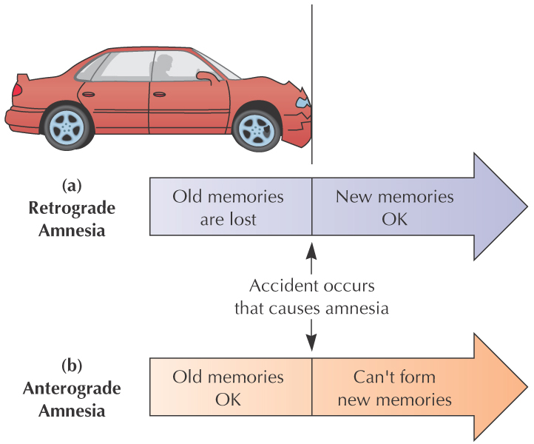
FORMS OF AMNESIA
(cont.)

Slide 41
Repression:
Refers to the inability to recall information, usually about stressful or traumatic events in persons' lives, such as a violent attack or rape. The memory is stored in long term memory, but access to it is impaired because of psychological defense mechanisms. Persons retain the capacity to learn new information and there may be some later partial or complete recovery of memory. This contrasts with e.g. anterograde amnesia caused by amnestics such as benzodiazepines or alcohol, where an experience was prevented from being transferred from temporary to permanent memory storage: it will never be recovered, because it was never stored in the first place. Formerly known as "Psychogenic Amnesia"

Slide 42
Memory impairments
Alzheimer disease: Initially starts with simple forgetting resulting in language and physical deterioration.Cuase can be defect in production of protein amyloid.
Korsakoff syndrome amnesia due to chronic alcohol.

Slide 43
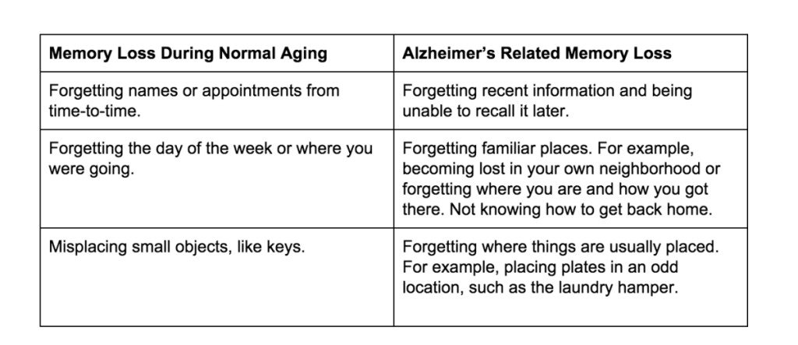
Alzheimer’s Disease

Slide 44
Interference theory
Interference theory (also known as retrieval interference (Roediger & Karpicke, 2006)) refers to the idea that forgetting occurs because the recall of certain items interferes with the recall of other items. In nature, the interfering items are said to originate from an over stimulating environment.

Slide 45
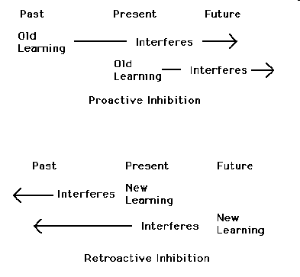
TYPES OF INTERFERENCE

Slide 46
Proactive interference
Underwood (1957) provided early evidence that things you've learned before encoding a target item can worsen recall of that target item. In a meta-analysis of multiple experiments, he showed that the more lists one had already learned, the more trouble one had in recalling the most recent one. This is proactive interference, where the prior existence of old memories makes it harder to recall newer memories.
e.g Psy----phil----problem in recalling philosophy

Slide 47
Retroactive interference
Retroactive interference occurs when later learning interferes with previous learning; i.e., learning new things somehow overwrites or obscures existing knowledge.
e.g Psy---phil----problem in recalling psychology

Slide 48
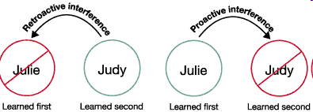

Slide 49
Interference-when information interferes
Study Psychology
Study Computer
Computer Test
Study Computer
Study Psychology
Psychology Test

Slide 50
Cue-dependent forgetting:
It is the failure to recall a memory due to missing stimuli or cues that were present at the time the memory was encoded. It is one of five cognitive psychology theories of forgetting. It states that a memory is sometimes temporarily forgotten purely because it cannot be retrieved, but the proper cue can bring it to mind. A good metaphor for this is searching for a book in a library without the reference number, title, author or even subject. The information still exists, but without these cues retrieval is unlikely. Furthermore, a good retrieval cue must be consistent with the original encoding of the information. If the sound of the word is emphasized during the encoding process, the cue that should be used should also put emphasis on the phonetic quality of the word

Slide 51
Case Study
Miss X met an accident. She stayed in coma for over a month. After she woke up, she was unable to remember her husband and her job. She only remembered her life 5 years back from the current date. She was even unable to remember that she was married or has moved to another city to continue her passion for arts.
Which type of forgetting is this?
Give rationale to explain your answer.
Write symptoms that explain the type of forgetting in this case.

Slide 52
Rubrics
Which type of forgetting is this?
  Retrograde Amnesia
Give rationale to explain your answer.
  Because the memory was lost about the events that has occurred before the trauma.

Slide 53
Write symptoms that explain the type of forgetting in this case.
  Unable to remember
  Did not recognize her husband
  Did not remember her husband and job
  Did not remember her shift to new city

